Slide 1
Lists
EECS 233

Slide 2
Previous Lectures
Memory management by PLs
OO programming, ADT
Recursion
Mathematical background and running time analysis
We start to learn “data structures” today!

Slide 3
How to Represent A Sequence of Data?
A sequence: an ordered (but not sorted) collection of items
  32, 5, 4, 24, 3, 5, 7, …
  “David”, “Mark”, “Grace”, “Tim”, “Tim”, “Michael”, “David”, …
Different from
  A bag, which is not ordered
  A set, which contains unique items

Slide 4
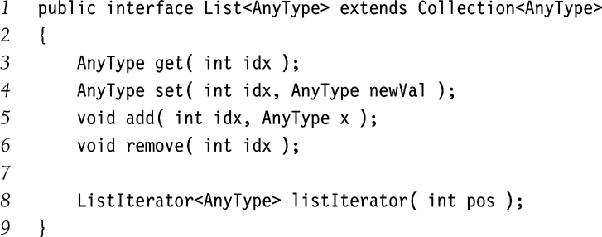
A List ADT
View list as a black-box object with certain operations
  Create a new (empty) list
  Get an i-th element
  Replace an existing element at position i with a new element
  Add a new element at position i
  Remove an element at position i
  Get the number of elements in the list
  Check if a given element (specified by its position i or by a reference) is the last in the list
  Etc…
Java list interface:
lst
???
Which data structures to use for implementation??

Slide 5
Array Representation
items
8
15
9
lst
numItems
3
maxSize
1000
Array List
Store list elements wall-to-wall in memory in an array
Keep a variable recording the current number of elements
Advantages
  Easy and efficient access to any item in the sequence
    items[i] gives you the item at position i
    Random access
      Every item can be accessed in constant time given its index
  Very compact: no auxiliary fields are required
Disadvantages of using an array:
  The need to specify an initial array size and resize as required (how?)
  Difficult to insert/delete items at arbitrary positions (running time?)
  May have many empty positions

Slide 6
Linked List Representation
lst
head
32
17
46
…
null
More efficient data structure for a dynamic sequence (with frequent insert/delete operations)
A linked list stores a sequence of items in separate nodes. Each node contains:
  a single item, and
  a “link” (i.e., a reference/pointer) to the node containing the next item
  The last node in the linked list has a link value of NULL or null.
The linked list starts with a variable that holds a reference to the first node – head of the list

Slide 7
Advantages/Disadvantages of Linked List
Advantages:
  No capacity limit (provided there is enough memory).
  Easy to insert/delete an item – no need to “shift over” other items.
    Done in constant time.
Disadvantages:
  No random access
    “walk down” the list to access an item
  Memory overhead for the links
head
32
x
17
46
…
null
63

Slide 8
Memory Management for Linked Lists
In an array, the elements occupy consecutive memory locations in the heap:
  Address in red
In a linked list, each node is a distinct object in the heap. The nodes do not have to be next to each other in memory.
0x800
0x804
0x808
32
17
46
…
0x800
0x400
0x528
0x430
0x640
head=0x400
32
17
46
…
0x528
0x430
0x000

Slide 9
An Example Linked List
A string represented using a linked list: LLString. Each node in the linked list represents one character.
Java classes
  public class StringNode {
    private char ch;
    private StringNode next;
    …
  }
head
‘c’
‘a’
‘t’
null
  public class LLString {
    private StringNode head;
    private int theSize;
    …

Slide 10
Under the Hood of the String Linked List
head
‘c’
‘a’
‘t’
null
The string as a whole will be represented (internally) by a variable that holds a reference to the node containing the first character.
  StringNode str1;
An empty string will be represented by a NULL value.
  StringNode str2 = null;
We will use helper methods that take the first node of the string as a parameter.
  We will have length(str1) instead of str1.length()
  This is necessary so that the methods can handle empty strings.
    if str1 == NULL, length(str1) will work, but str1.length() will produce a runtime error

Slide 11
More on References
A reference is also a variable
  that has its location in the memory, and
  whose value is the address (i.e., location) of data
  e.g., first: address=0x300, value=0x400
  How about first.next.next ?
  How about first.next.ch ?
0x300
0x400
0x528
0x430
first
0x400
‘c’
‘a’
‘t’
0x528
0x430
null

Slide 12
More on References
Example: temp.next.ch
  Start with expression: “temp.” It represents the node to which temp refers.
  Now consider “temp.next”. It represents the field “next” of the node to which temp refers.
    address = ?
    value = ?
  Next, consider “temp.next.”. It represents the node with address 0x430.
  Finally, temp.next.ch represents ‘t’.
0x300
0x400
0x528
0x430
first
0x400
‘c’
‘a’
‘t’
0x528
0x430
null
0x304
temp
0x528

Slide 13
Recursion on Linked Lists
Recursive definition of a linked list: a linked list is either
  empty or
  a single node, followed by a linked list
Recursive definition lends itself to recursive methods.
Example: length of a string
  length of “cat” = 1 + length of “at”
  length of “at” = 1 + length of “t”
  length of “t” = 1 + length of the
  empty string (which is 0)
private static int length(StringNode str) {
if (str == null)
return 0;
else
return 1 + length(str.next);
}
0x300
0x400
0x528
0x430
str
0x400
‘c’
‘a’
‘t’
0x528
0x430
null

Slide 14
Doubly Linked List
null
‘a’
‘h’
‘t’
lst
lst_head
lst_tail
Both next and prev are defined in StringNode
Why needed?
  public class LLString {
    private StringNode lst_head;
    private StringNode lst_tail;
    private int theSize;
    …
null
  public class StringNode {
    private char ch;
    private StringNode next;
    private StringNode prev;
    …
  }

Slide 15
Example: Traversing Linked List
Access the node at position i in a doubly linked list
  public StringNode getNode(int i) {
    if (i < 0 || i >= theSize) throw new Exception(“Index out of bounds”);
    StringNode ptr;
    if (i < theSize/2) {
      ptr = lst_head;
      for (j = 0; j != i; j++) ptr = ptr.next;
    } else {
      ptr = lst_tail;
      for (j = theSize-1; j != i; j--) ptr = ptr.prev;
    }
    return ptr;
  }
  What is the running time?

Slide 16
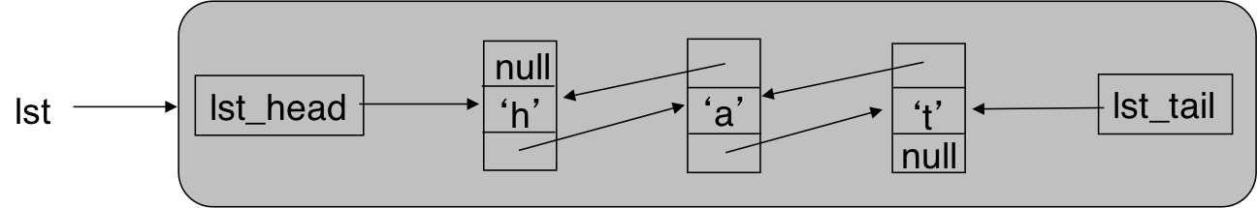
Example: Removing a Node
  public char remove(StringNode p)
  {
    p.next.prev = p.prev;
    p.prev.next = p.next;
    theSize--;
    return p.ch;
  }
  Do we need to explicitly de-allocate p?
…
…
p
    if (p == lst_head || p == lst_tail)
    ?

Slide 17
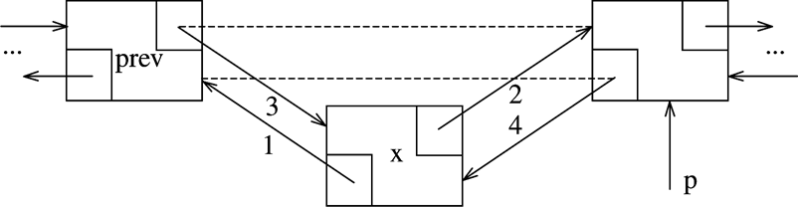
Example: Inserting a Node
Insert a new node before p.
  What if p is the first element? Last element?
  What if p == null?
  What if p is not part of a list?

Slide 18
Other Operations
Either simple linked list or doubly linked list
Count the occurrences of an item in the linked list
Remove all occurrences of an item
Reverse a linked list (trivial for doubly linked list)
Duplicate a linked list

